Slide 1
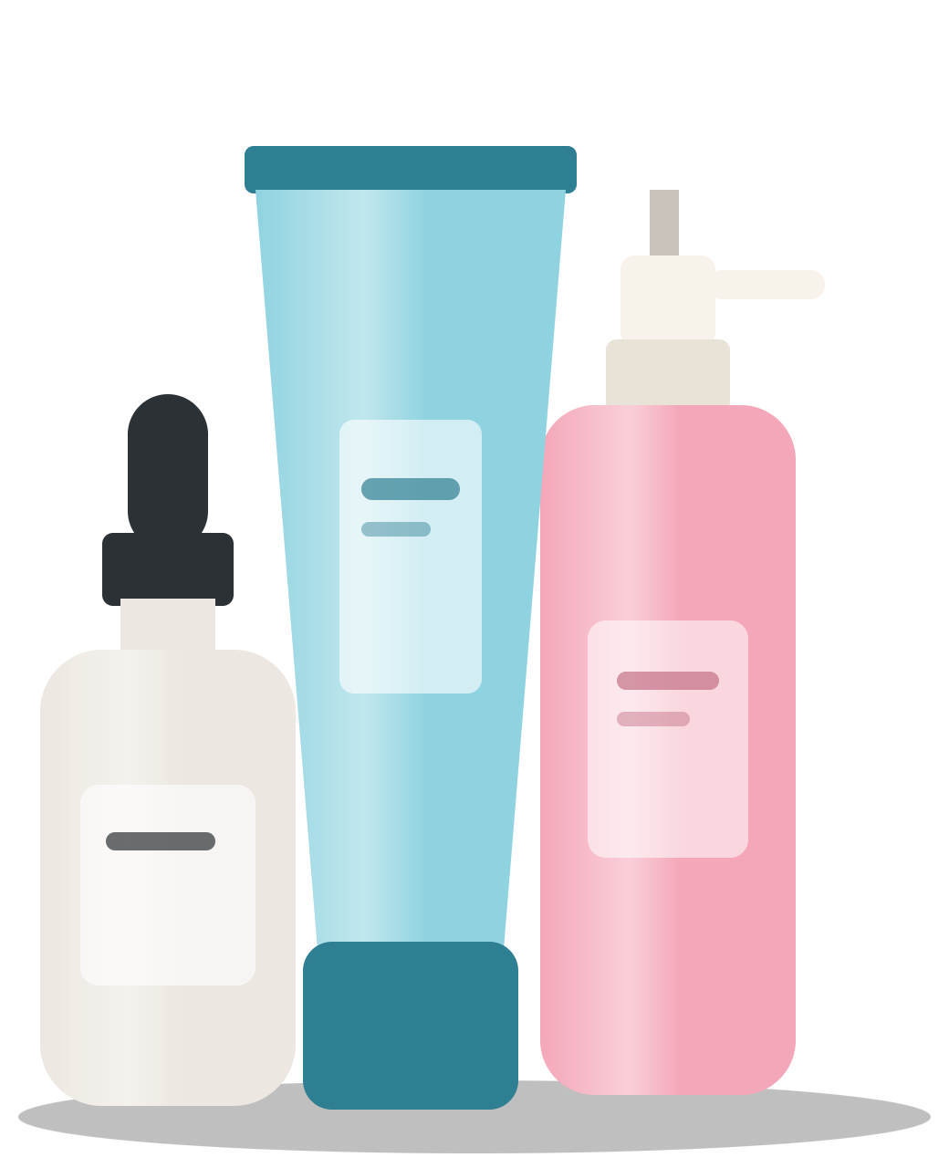
What 1,140 reviews say three sunscreen brands must fix
BRAND HEALTH AUDIT · NOVEMBER 2026
Aspect-based sentiment audit of Aqualogica, Minimalist and Dot & Key, and the pack and comms moves the data supports
Dot & Key
Aqualogica
Minimalist
+27.3
−15.8
−56.7
Net Sentiment Score, −100 to +100
Saumya Singh· 1,140 Nykaa reviews · Gemini ABSA, 95% sentiment agreement with hand labels
Notes:
Open with the problem: traditional brand trackers lag by about 90 days and plain sentiment scores blur mixed reviews. This audit splits every review into the aspects it mentions, so we can see exactly what each brand wins and loses on. Headline: Dot & Key is net positive; Aqualogica and Minimalist are net negative, for different reasons.

Slide 2
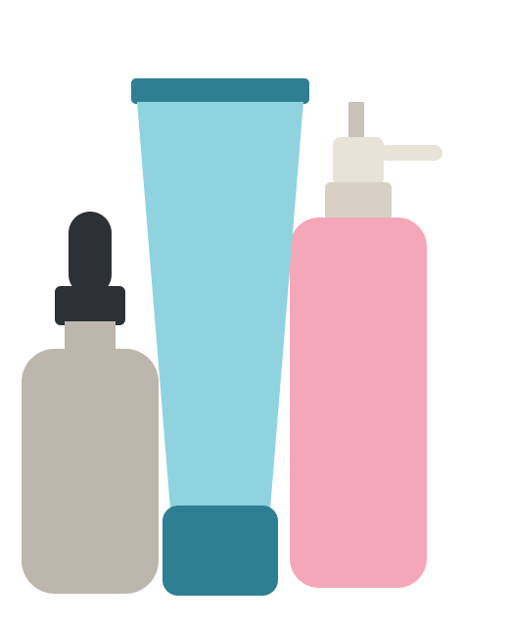
Texture and skin fit decide the category; Minimalist loses on both
CONSUMER DIAGNOSTIC · NET SENTIMENT SCORE BY PILLAR
Pillar
Aqualogica
Dot & Key
Minimalist
53%
Texture & Finish
+14.7
+40.3
−66.5
of all 1,913 mentions are about texture, with 17× the complaints packaging gets (534 vs 31)
Skin Compatibility
−68.9
−35.7
−83.2
82%
Overall Experience
+50.7
+71.8
+45.5
of skin-fit mentions are complaints: the most criticised pillar
Sun Protection
−23.3
+16.4
+18.4
Packaging*
−58.3
0.0
−42.9
+40.3
All pillars
−15.8
+27.3
−56.7
Dot & Key’s texture score, the benchmark to protect: light, no white cast. Its one gap: pilling under makeup (30).
Score = (positive − negative) ÷ mentions × 100. *Packaging: 45 mentions, directional only.
Source: Power BI brand health dashboard · 1,913 aspect mentions from 1,140 reviews, 380 per brand
02
Notes:
One slide for the whole diagnosis. More than half of what buyers talk about is texture, and skin fit is where they complain most: 82% of those mentions are negative. Packaging barely comes up. Minimalist is last on both big pillars, which is why its total is −56.7, though buyers do trust its sun protection (+18.4, the best of the three). Aqualogica’s weak spot is skin compatibility. Dot & Key leads on texture; what buyers praise across all brands is a light texture with no white cast, so every fix must protect that. Dot & Key’s only real gap is pilling, a usage-guidance fix.

Slide 3
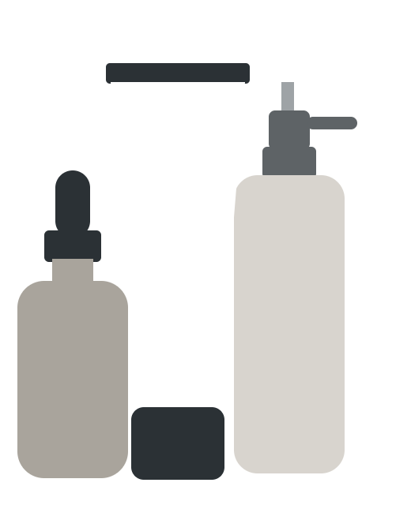



Minimalist reaches the wrong skin; the pack must say who it’s for
MINIMALIST · PROBLEM AND PACK FIX
77.1%
BEFORE
AFTER
of its 658 mentions are complaints (all brands: 56.2%); 123 of 380 reviews are high churn risk
Dry & normal skin
MINIMALIST
Matte
Dewy
TOP COMPLAINTS · MENTIONS
SUNSCREEN
SPF 50
SUNSCREEN
Greasy Oily Feel
118
SPF 50
White Cast Issue
83
Unsuitable For Oily Skin
33
PA++++
PA++++
“It’s good for normal skin. But not for oily or combination skin.”
SPF claims only
Oily skin? Try [matte SKU] →
Same badge on the first listing image on Blinkit, Zepto, Nykaa and Amazon, legible at 150 × 150 px. White cast (83) and pilling (48) go to an R&D texture brief.
Source: Minimalist, 380 reviews · quote verbatim · pack is a concept mock-up, not brand artwork
03
Notes:
Minimalist has the worst score, but its reviewers explain why: it is too greasy for oily skin and they say it would suit dry or normal skin. The product is not failing everyone; it is failing the oily-skin buyers who pick it without knowing. The fix is to let buyers self-select before checkout: a badge in the top third of the pack with skin type and a five-step finish meter, dark text on a solid band, the same badge on every listing's first image because quick-commerce buyers decide from a thumbnail. The cross-sell line sends oily-skin buyers to a matte variant. It is an artwork change, so it can be A/B tested on listing images quickly. White cast and pilling are texture problems for R&D, not the pack.

Slide 4
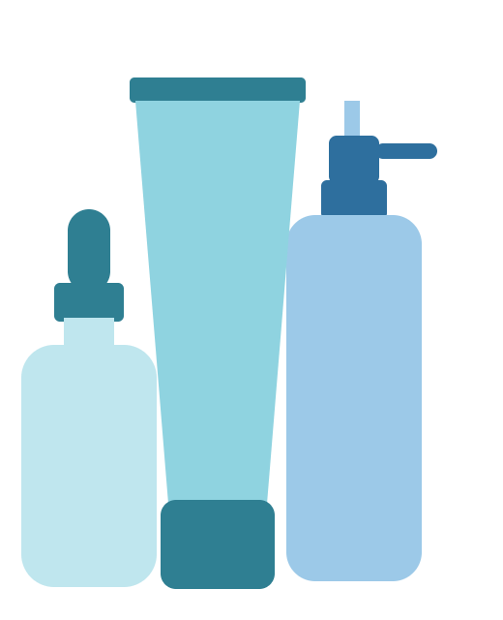
Aqualogica’s skin reactions are breaking trust
AQUALOGICA · DEEP DIVE AND INTERVENTION
34.5%
1
Root-cause the reactions (R&D and QA)
Check batches and the formula behind breakout and irritation reports. Test whether “darkening” is a reaction or tanning from too little product.
of its 380 reviews carry high churn risk (131): the highest of the three brands
MENTIONS · HIGH-CHURN REVIEWS
2
Fix the claims and the pack
Causes Breakouts
Add “patch test before first use” and skin-type guidance. Run non-comedogenic testing before making that claim.
47 · 46
Skin Darkening
44 · 25
3
Close the loop on listings
Skin Irritation Burning
Reply to every reaction review with a care route; add dermatologist content on how much to apply and when to reapply.
29 · 28
“This product for 500, I have almost spent my 4k to the doctor. Choose wisely.”
Source: Aqualogica, 380 reviews · bar label = negative mentions · second number = high-churn reviews citing it
04
Notes:
Aqualogica’s texture is liked — no white cast and lightweight are its top praise — so this is not a texture problem. It is a skin-reaction problem, and those are the complaints most tied to churn: almost every breakout and irritation complaint comes from a review flagged high churn. Order matters: first find out what is causing the reactions, because a pack or comms fix on top of a real formulation issue would damage trust further. Darkening is worth testing separately; it may be under-application leading to tanning rather than a reaction. Quote is verbatim; ₹500 product, ₹4,000 doctor bill.

Slide 5
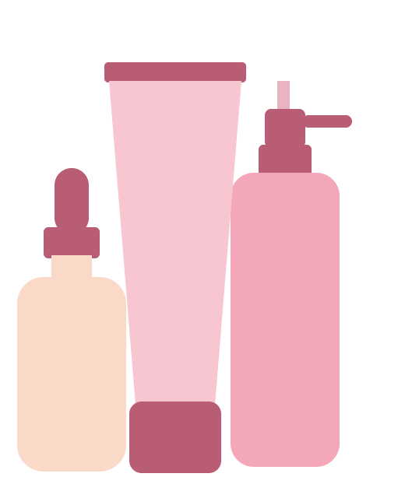
Dot & Key leads on texture; pilling is its one gap
DOT & KEY · PROTECT AND POLISH
+27.3
1
Protect the texture
Don’t change the base formula. Lead every Nykaa listing and ad with what buyers praise: lightweight, no white cast.
Net Sentiment, the best of the three, and the lowest churn risk: 80 of 380 reviews (21.1%)
BUYERS LOVE · MENTIONS
2
Fix pilling with usage guidance
Lightweight Texture
81
“It peels off when reapplying,” one buyer writes. Add “let it set before makeup” and “pat, don’t rub, to reapply” to pack and listing.
No White Cast
61
Quick Absorption
43
BUYERS DISLIKE · MENTIONS
3
Check makeup compatibility (R&D)
Pilling Under Makeup
30
Test it under common primers and foundations. If pilling persists, brief a tweak that keeps the light feel.
Greasy Oily Feel
28
White Cast Issue
24
Source: Dot & Key, 380 Nykaa reviews · bar lengths on one scale · quote verbatim
05
Notes:
Dot & Key is the healthy brand: the best Net Sentiment and the fewest at-risk reviews. Its praise is all about texture, so the first job is not to break what works. Its biggest texture complaint is pilling: the sunscreen rolls or peels when makeup or a second layer goes on top. That is often about how it is applied, so start with cheap usage guidance on pack and listing, measure whether pilling complaints fall, and only then ask R&D for a formula tweak. Note the bars share one scale: praise for lightweight texture (81) is nearly three times the pilling complaints (30).

Slide 6

These fixes target 6 in 10 of the customers we’re likely to lose
WHY IT MATTERS
1,140
334
198
Nykaa reviews analysed
are likely to stop buying (29%)
complain about a problem these fixes target
Where they are
If we win back half of them
How we prove it
Aqualogica 92 · Minimalist 70 · Dot & Key 36
Customers likely to stop buying fall from 29% to 21% of reviewers.
Test the new pack image against the current one on Nykaa and compare 90-day repeat purchases.
“Likely to stop buying” = won’t rebuy, returned it, warned others or had a reaction · likely undercounted
06
Notes:
Read it left to right. Of 1,140 Nykaa reviews, 334 come from people likely to stop buying: they said they won’t rebuy, returned the product, warned others, or had a skin reaction. Of those 334, 198 complain about exactly the problems the previous slides fix: skin-type fit and texture for Minimalist, skin reactions for Aqualogica, pilling for Dot & Key. So the fixes aim at 6 in 10 of the customers at risk. If we won back half of them, the at-risk share would drop from 29% to about 21%. That is an illustration, not a forecast; the real proof is an A/B test of the new pack image and 90-day repeat purchases. To put a rupee value on it, multiply customers kept by average order value and orders per year from the brand’s own data.

Slide 7
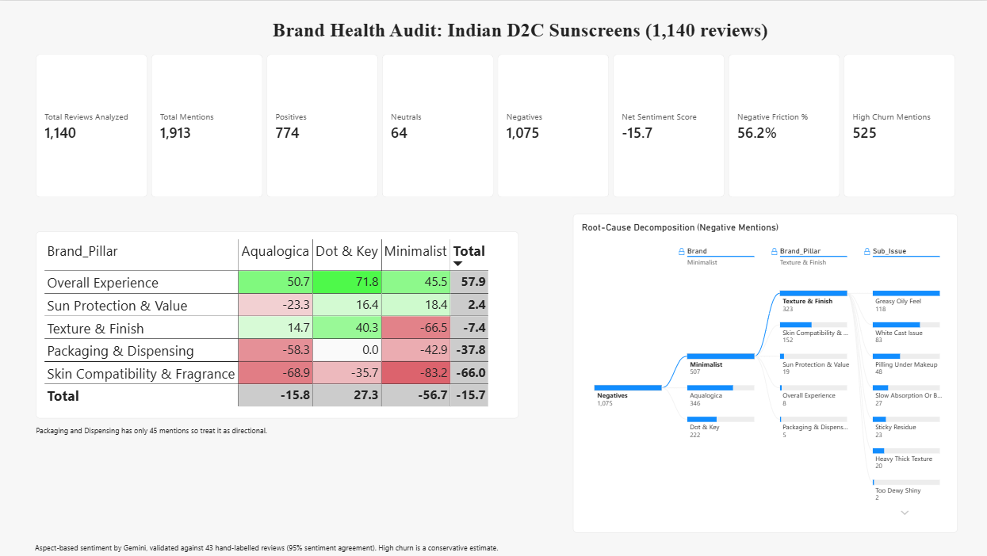
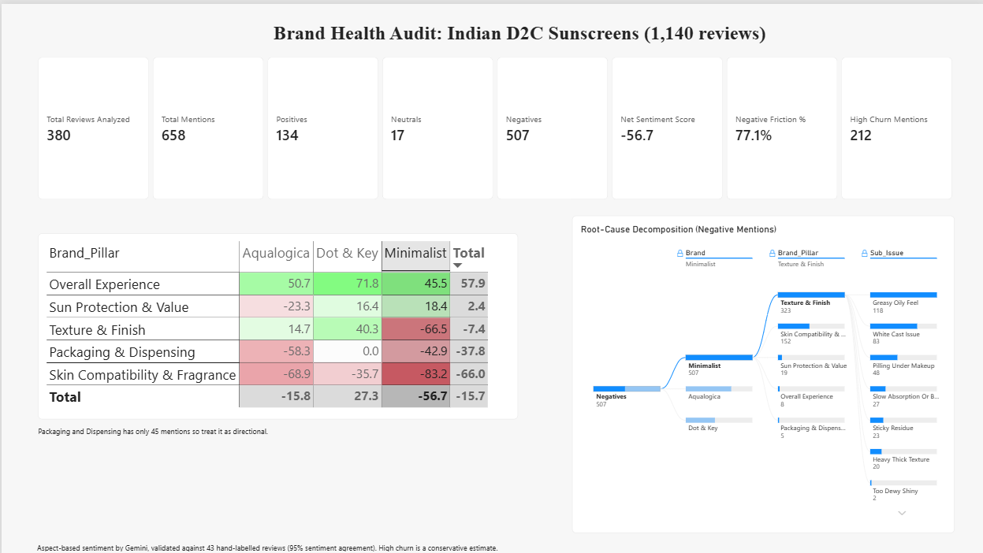
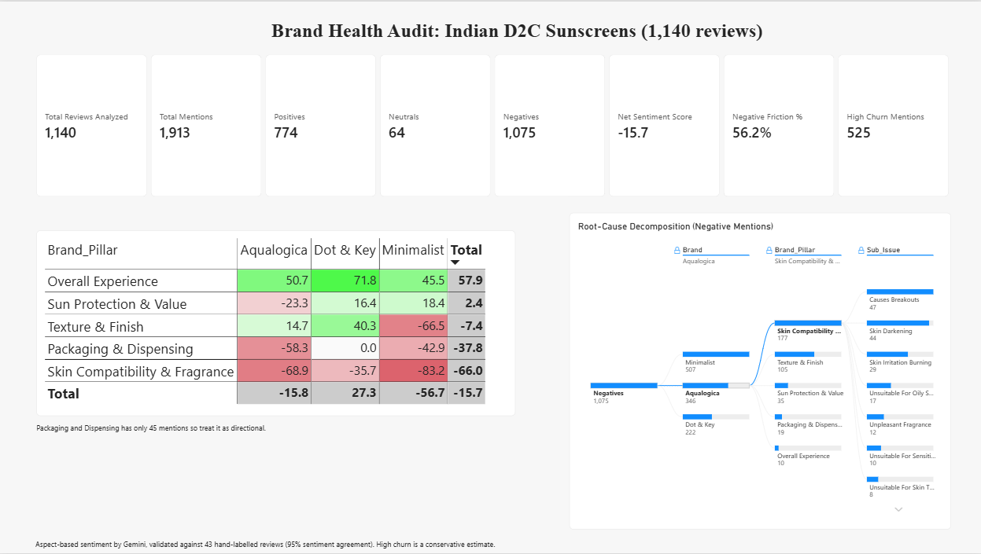
The Power BI dashboard behind every number
APPENDIX · THE EVIDENCE
Filtered to Minimalist
Drill-down: Aqualogica → Skin Compatibility
Full view: KPI cards, competitive matrix, root-cause tree
Power BI Desktop · 1,913 aspect rows · 95% sentiment agreement with 43 hand-labelled reviews
07
Notes:
Every number in this deck comes from this dashboard. The matrix colours each brand and pillar by Net Sentiment Score; the decomposition tree breaks complaints down from brand to pillar to the exact issue; the cards give the totals. Clicking a brand filters the whole page, as in the Minimalist view. If asked how it was built: Nykaa reviews, cleaned and balanced to 380 per brand, split into aspects by Gemini with strict JSON output, checked against 43 hand-labelled reviews, then loaded into Power BI with a handful of DAX measures.

